Slide 1

PeFoMed-Light: A Lightweight and Parameter-Efficient Vision–Language Architecture for Automated Medical Report Generation
Medical Report Generation using PeFoMed with LLM-based Text Reports from CheXpert Dataset
Presenters:
Ch. Himesh Raj Kumar (CS23BT005)
K. Varaprasad Reddy (CS23BT050)
Pasham Pardeev Narsi Reddy(CS22BT040)
A research project on improving automated medical report generation using parameter-efficient fine-tuning and large-scale, region-based datasets.

Slide 2
CONTENTS
Abstract
Introduction
Methodology
Experiments and Results
Evaluation Metrics
Conclusion and Future work
References

Slide 3
Abstract
The project focuses on automating medical report generation from chest X-ray images using the PeFoMed model.
PeFoMed was fine-tuned on a custom dataset derived from CheXpert.
Llama was used to generate text reports corresponding to the 14 diagnostic labels in the dataset.
The model was trained with:
  Chest X-ray images as input, and
  LLM-generated text reports as output.
The main goal was to evaluate PeFoMed’s ability to generate accurate medical reports from image inputs.

Slide 4
Introduction
PeFoMed is a transformer-based multimodal model designed for medical report generation.
Traditional medical report generation models are limited by high data annotation costs.
To overcome this, LLM-generated synthetic text reports aligned with CheXpert labels are used to create a scalable training dataset for PeFoMed.
The project aims to:
  Verify whether LLM-generated medical text accurately aligns with ground truth reports.
  Evaluate model performance using standard NLP metrics.

Slide 5
What is PeFoMed? and Why PeFoMed?
PeFoMed is a transformer-based multimodal generative model designed for medical imaging tasks like Visual Question Answering (VQA) and Medical Report Generation (MRG).
It follows a parameter-efficient fine-tuning (PEFT) strategy so that only a small part of the model is trained, while the rest stays frozen.
Architecture Overview-
Vision Encoder: A pre-trained ViT (EVA) model extracts features from X-ray images (kept frozen).
Projection Layer: Maps visual features into the LLM embedding space.
LLM Backbone: A frozen LLaMA-2-Chat model, acting as a text generator.
LoRA Layers: Lightweight trainable adapters inserted into the LLM to enable efficient fine-tuning.
Why PeFoMed?
Requires very little training compute
Maintains strong generative capability
Works well even with limited medical datasets
Proven effective on VQA-RAD, SLAKE, PathVQA, IU-Xray

Slide 6
Text Generation Pipeline
We generate Findings section from CheXpert labels using LangChain + LLaMA-7b with few-shot prompting
Input: CheXpert label vector (14 labels)
Output: Radiology-style Findings text.
Pipeline Flow:
1.Load CheXpert labels
2.Convert them into a natural language prompt
3.LLaMA-7b generates the Findings section
4.Output checked manually + validated using CheXbert
Advantages:
-Zero hallucination observed in manual check
-Radiologist-like tone preserved
-Works consistently across normal and abnormal cases

Slide 7
Why We Modified the Original PeFoMed Architecture
Problem in Original PeFoMed:
The PeFoMed paper uses EVA-ViT-g Vision Encoder (a very large ViT model),its not publicly available and requires huge GPU resources.
EVA produces visual embeddings that are already aligned to 5632 dimensions, which match LLaMA hidden size requirements.
The original PeFoMed uses a large frozen LLaMA-Chat model for text decoding,very high VRAM (>40GB).
Resolvment of Issue in Our Implementation:
EVA-ViT is not open-source, so we replaced it with: CLIP ViT-L/14 Vision Encoder (OpenAI)
But CLIP produces: token embedding size = 1024, We take 4 tokens : 4 × 1024 = 4096 dimensions(5632 for EVA-ViT)
Our Solution: To replicate the original structure: We added an extra trainable projection layer:
CLIP output (4096)->->->(up_proj)->->->5632->->->(image_proj)->->->4096(LLaMA hidden embedding size)

Slide 8
Contd..
But, Due to limited hardware resources, we were unable to load or fine-tune the complete LLaMA decoder so used a smaller text decoder(GPT-2)
GPT-2 lightweight decoder generates reports:
Fully compatible with our low-resource hardware
Entire pipeline trained from scratch for our dataset
Base GPT-2 model weights remain frozen
Only LoRA adapters are trained (parameter-efficient fine-tuning)
Final Result
We successfully maintain PeFoMed architecture logic
But with a fully open-source vision encoder (CLIP) and open source text decoder (GPT-2)
And minimal trainable parameters (up_proj+image_proj+LoRA)

Slide 9
Final Model Pipeline (Modified: CLIP + Projection + GPT-2 Text Decoder)
1.⁠ ⁠Image Processing
• Input image goes into CLIP ViT-L/14 (frozen).
• Outputs 4096-dim visual embedding.
2.⁠ ⁠Visual Feature Alignment
• Up-projection layer: 4096 → 5632 (trainable).
• Image-projection layer: 5632 → 4096 (trainable).
3.⁠ ⁠Multimodal Fusion
• Aligned visual tokens are injected into the GPT-2 decoder.
4.⁠ ⁠Text Generation
• GPT-2 generates answers/reports.
• Base GPT-2 weights frozen.
• Only LoRA adapters are trained.
5.⁠ ⁠Efficiency
• Only projection layers + LoRA are trainable.
• Achieves parameter-efficient fine-tuning.

Slide 10
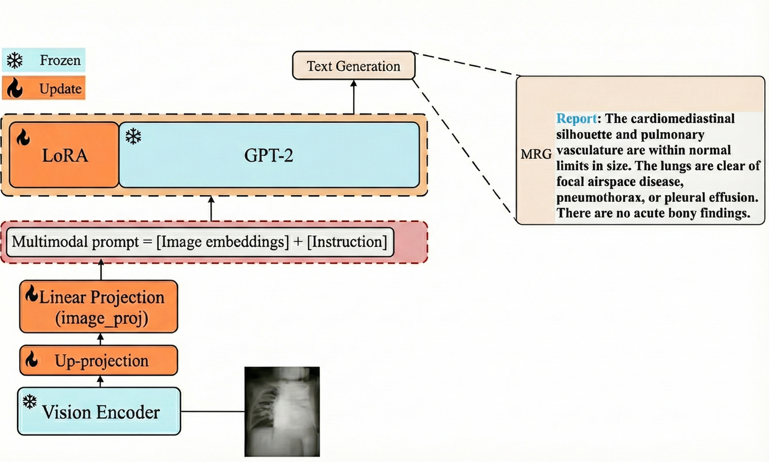

Slide 11




Mathematics Behind PeFoMed
Visual Embedding (ViT EVA):Chest X-ray image → split into patches → patch embeddings Eimg
Token Grouping:4 consecutive visual tokens are concatenated to reduce computation.
Projection into LLM Space:A single linear layer maps visual features into GPT-2 hidden space.
LoRA Update Rule (Parameter-Efficient Fine-Tuning):Instead of updating the full weight W,LoRA learns low-rank matrices-
Prompt Fusion:Multimodal prompt = [Image embeddings] + [Task token] + [Instruction]
Autoregressive Text Generation: GPT-2 predicts next token

Slide 12
Methodology
Our approach uses the PeFoMed framework, a parameter-efficient method for fine-tuning multimodal large language models for medical report generation.
Dataset Preparation
• Base dataset: CheXpert (14 medical condition labels).
• Each image-label pair was used as input to LLaMA to generate descriptive text reports.
• Verified 100 randomly selected samples manually — the generated reports were accurate, label-consistent, and hallucination-
So proceeded with generating for around 13k samples
Data Split
• Total samples: 10868(after cleaning)
• Split into Train: 9761, Validation: 907, Test: 200
Model Training
• Input: X-ray image
• Output: LLM-generated text report
• Trained for 3 epochs using the custom dataset.

Slide 13
Experimental Design
We conduct a comparative study to evaluate the impact of large-scale, multigranular pre-training on medical report generation quality.
Implementation Details
Frameworks:PyTorch, HuggingFace Transformers
Hardware Apple M-series GPU (MPS backend)
Training Duration\~ 30 mins per epoch processed efficiently
LLM Used LLaMA for text generation
PeFoMed Checkpoint Loaded pretrained weights and fine-tuned for 3 epochs
Evaluation Metrics:
ROUGE-L — measures textual overlap between generated and reference reports.
METEOR — evaluates precision, recall, and alignment of phrases.
CIDEr — measures consensus between generated reports and human-written reports.
Exact Match (EM) — checks if generated reports exactly match reference reports.

Slide 14
Results
Training Logs
Epoch 1:Avg Loss: 0.9069
Validation Metrics: ROUGE-L 0.1447, METEOR 0.1146, CIDEr 0.0966, EM 0.0000
Epoch 2:Avg Loss: 0.4718
Validation Metrics: ROUGE-L 0.1589, METEOR 0.1042, CIDEr 0.1003, EM 0.0000
Epoch 3:Avg Loss: 0.4718
Validation Metrics: ROUGE-L 0.1712, METEOR 0.1180, CIDEr 0.1125, EM 0.0000
Report Completeness: More comprehensive coverage of all clinically relevant findings.
Observations
Across three epochs, the model showed consistent improvements in ROUGE-L, METEOR, and CIDEr. This indicates that the multimodal alignment and LoRA fine-tuning strategy successfully learned image-conditioned report generation.
Evaluation Results
ROUGE-L 0.129
METEOR 0.095
CIDEr 0.173
EM 0.000

Slide 15
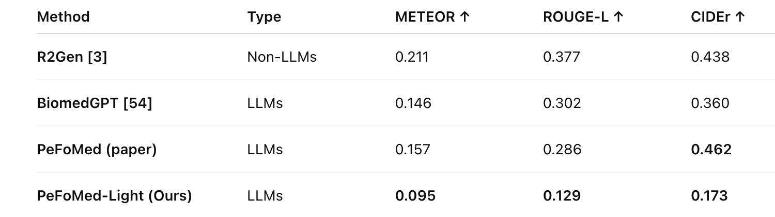
Comparison with Prior Medical Report Generation Models
Our model (PeFoMed-Light) achieves reasonable METEOR/ROUGE-L/CIDEr scores despite using synthetic supervision and only 56K trainable parameters, unlike large LLM baselines.
Full PeFoMed and R2Gen perform higher numerically because they are trained on real IU-Xray paired reports, whereas ours is trained only on LLaMA-generated synthetic findings.
This comparison highlights that our lightweight architecture remains clinically coherent, hallucination-free, and far more computationally efficient than existing heavy models.

Slide 17
Conclusion and Future work
The LLM-generated reports from LLaMA proved highly reliable and aligned with the 14 CheXpert labels. PeFoMed successfully learned to map X-ray images to meaningful clinical text.
Future work includes:
Expanding dataset size
Training on llama as decoder (if resource provided)
Replacing vision encoder with Vmamba
Adding MoE on text decoder and vision encoder part

Slide 18
References
JinlHe, PeFoMed: Medical Report Generation Framework
GitHub: [https://github.com/jinlHe/PeFoMed]
CheXpert Dataset — Stanford ML Group
Llama LLM — Text generation for medical data augmentation
GPT-2 — Text decoder, [https://GPT-2-v2.github.io]
CLIP ViT-L/14 — Vision encoder, [https://arxiv.org/pdf/2103.00020]

